Slide 1

Vehicle Tracking System

Slide 2




Project analysis slide 5
Main Functionality
GPS Detects Location
Data is Processed
Send Data through GSM
Website Maps Out Vehicle's Track

Slide 3





Project analysis slide 3
Main Features
Layered Architecture
DMA
RTOS
Curve Detection
Web Interface & Location Visualization

Slide 4
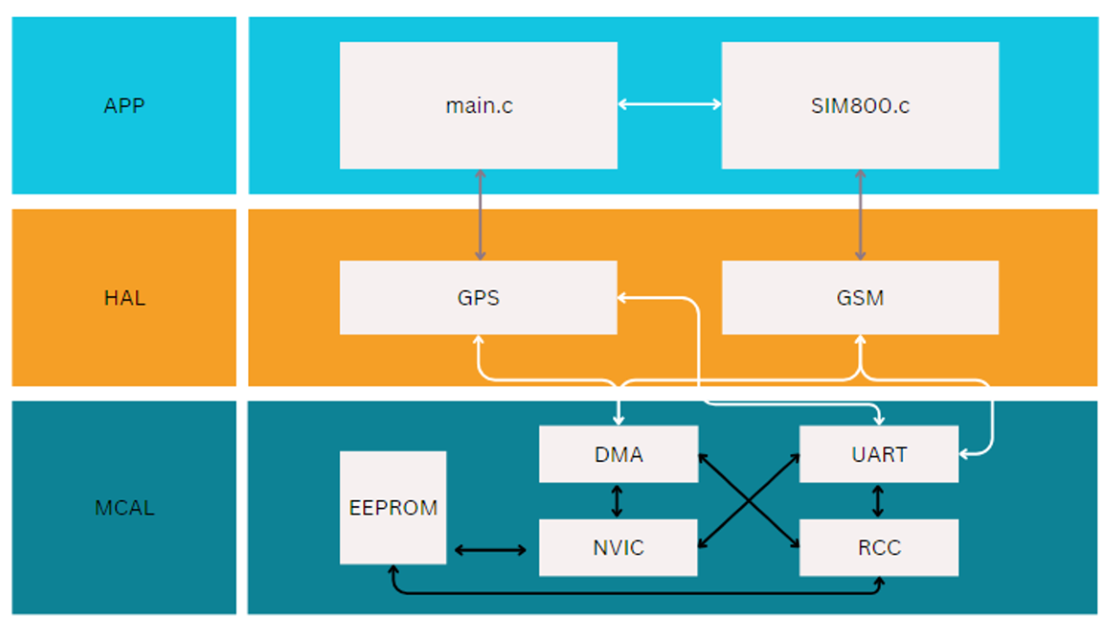
Project analysis slide 4
Layered Architecture

Slide 5
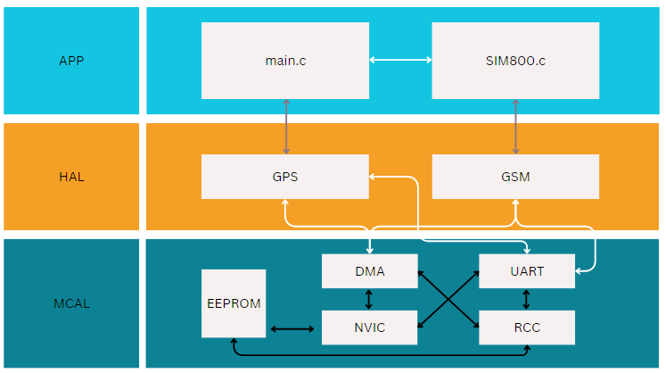
Project analysis slide 4

Slide 6
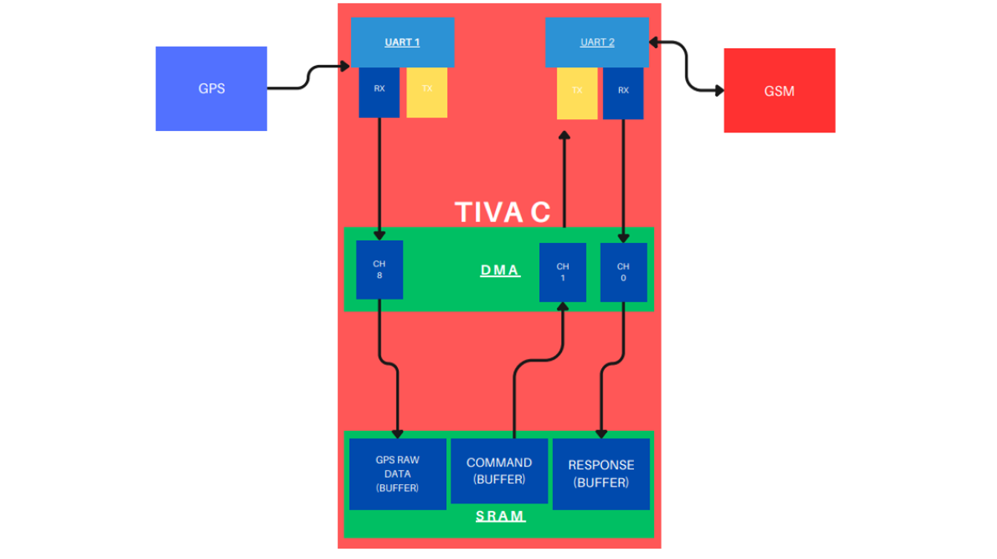
Project analysis slide 4
DMA

Slide 7
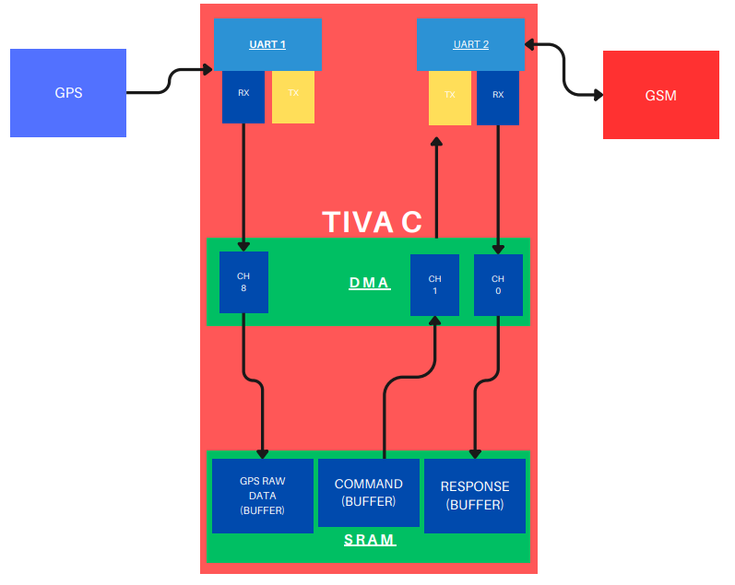
Project analysis slide 4

Slide 8






Project analysis slide 2
RTOS Tasks
GPS Parse
Set Timer Rate
RTOS
GPS Read
GSM Send Sequence
GPS Process Data
GSM Check Connection

Slide 9
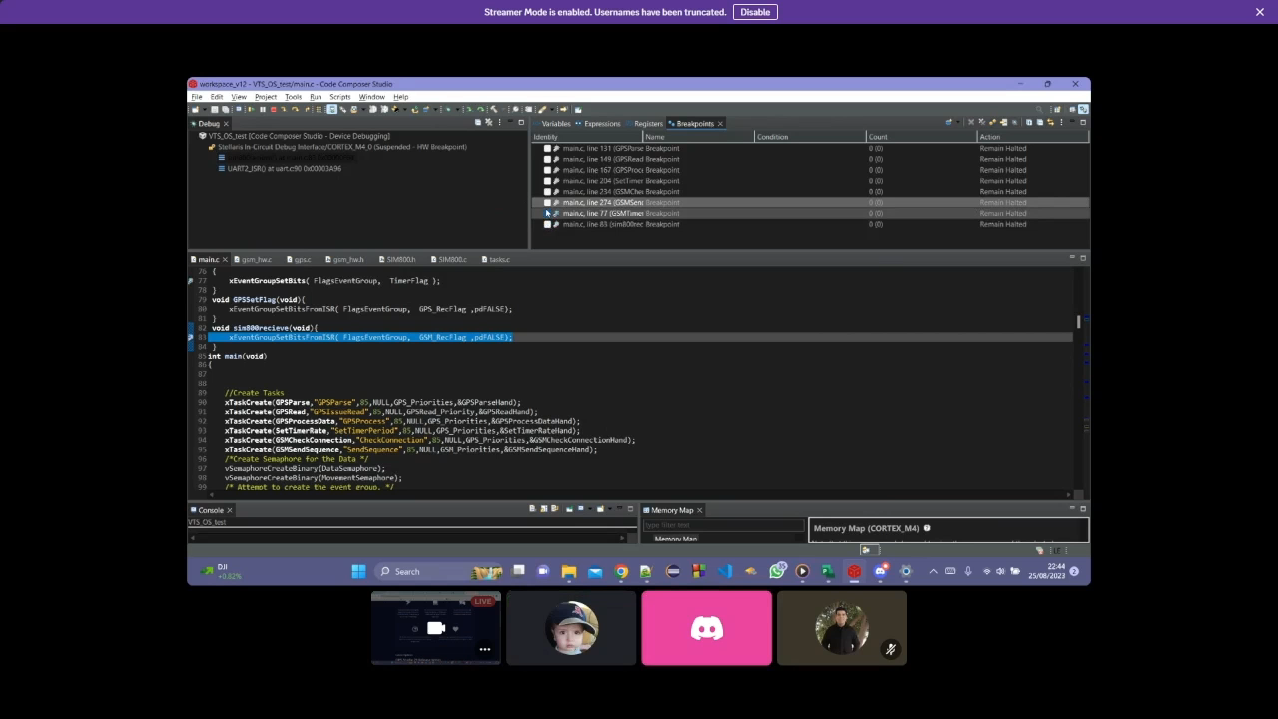
Project analysis slide 2
Project Demo

Slide 10
Project analysis slide 4
Challenges
GPS Parsing
GPS integration and data handling.
FreeRTOS Porting
Code Composer compilers don’t support FreeRTOS
Hardware Faults
GSM power and soldering
U-Turn Detection
Absence of GPS data

Slide 11
Project analysis slide 4
System Initialization
Hardware Initialization
Event Group Creation & FreeRTOS Timer Initialization
Task Creation
Interrupt Integration with FreeRTOS
GSM Connection Setting
Issue First GPS Read
Start Scheduler

Slide 12
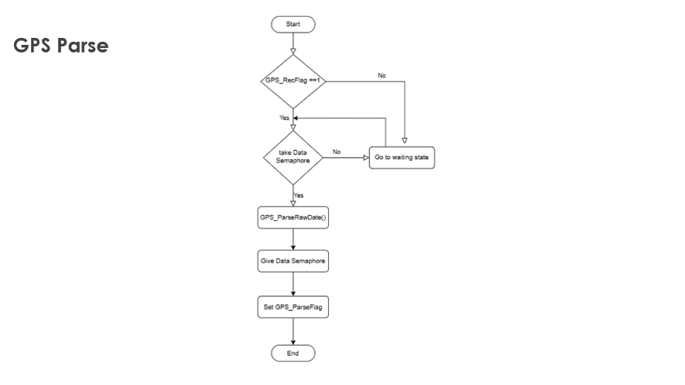
Project analysis slide 10
GPS Parse
GPS_RecFlag is set by hardware when DMA fills GPS_RawData buffer.
GPS_ParseRawData retrieves required information.
GPS_ParseFlag is set to initiate next task.

Slide 13
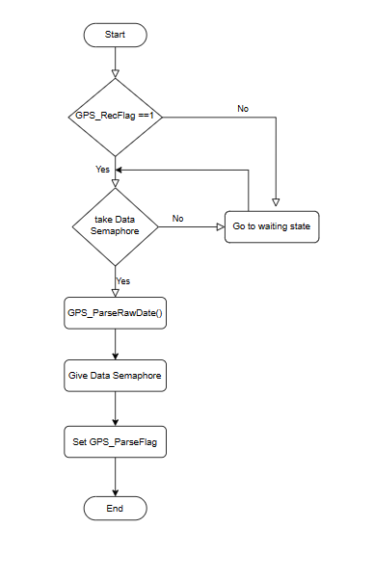
Project analysis slide 4
GPS Parse

Slide 14
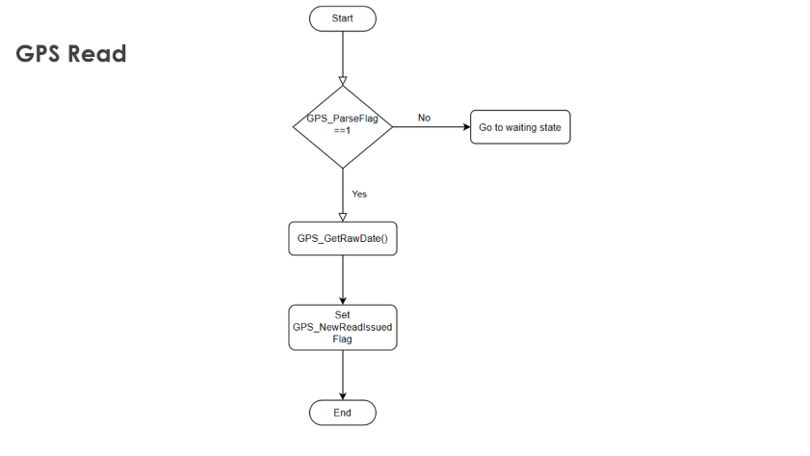
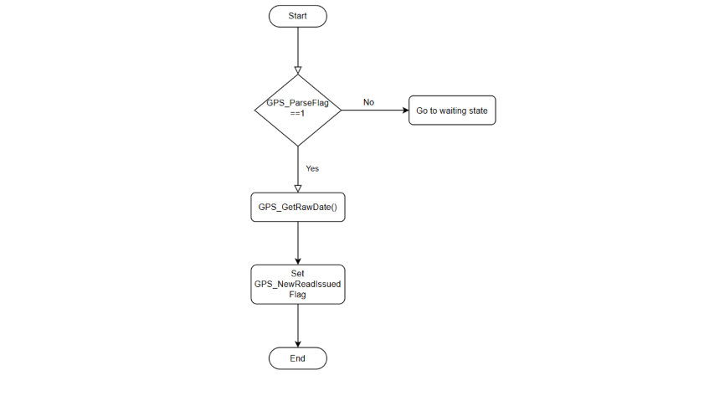
Project analysis slide 4
GPS Read
GPS_GetRawData enables DMA channel to start reception
GPS_NewReadIssued Flag is set to initiate next task.

Slide 15
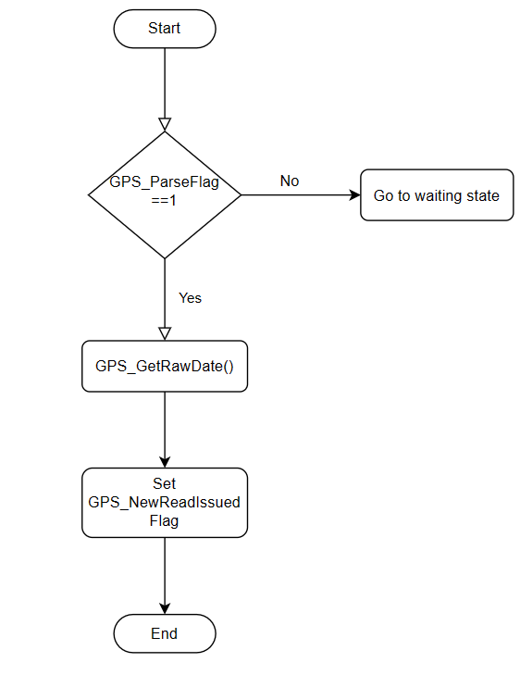
Project analysis slide 4
GPS Read

Slide 16
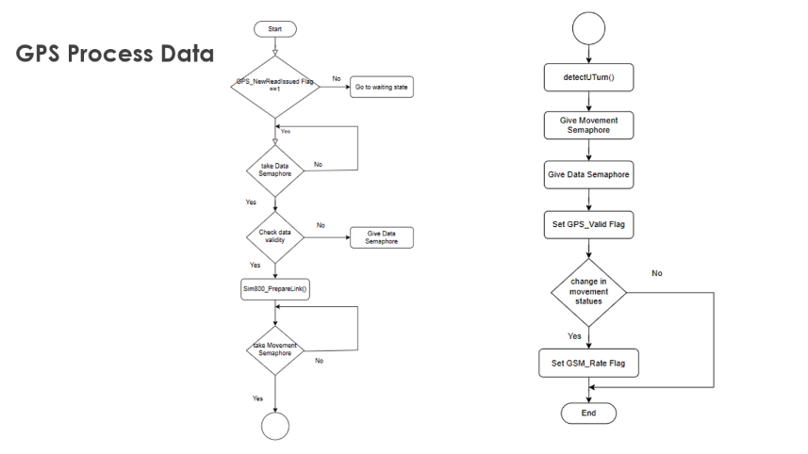
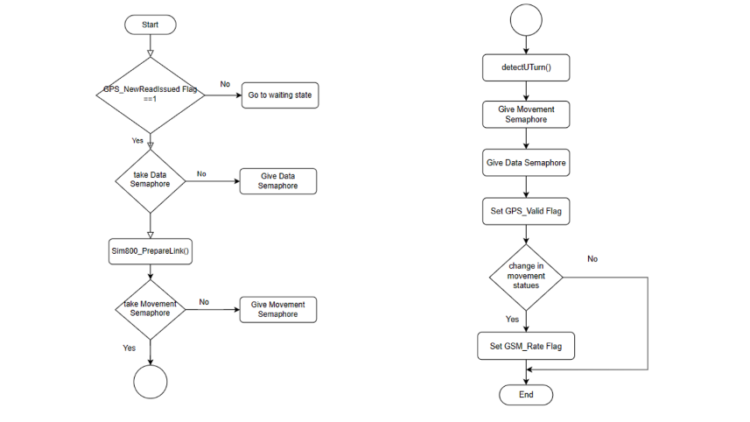
Project analysis slide 4
GPS Process Data
Sim800_PrepareLink injects the location data into the URL that will be requested through GSM.
GPS_DetectUTurn is a function that determines whether the vehicle is moving in a straight line or in a curve.
If there was a change in movement pattern, GSM_Rate Flag is set to activate Set Timer Rate task.

Slide 17
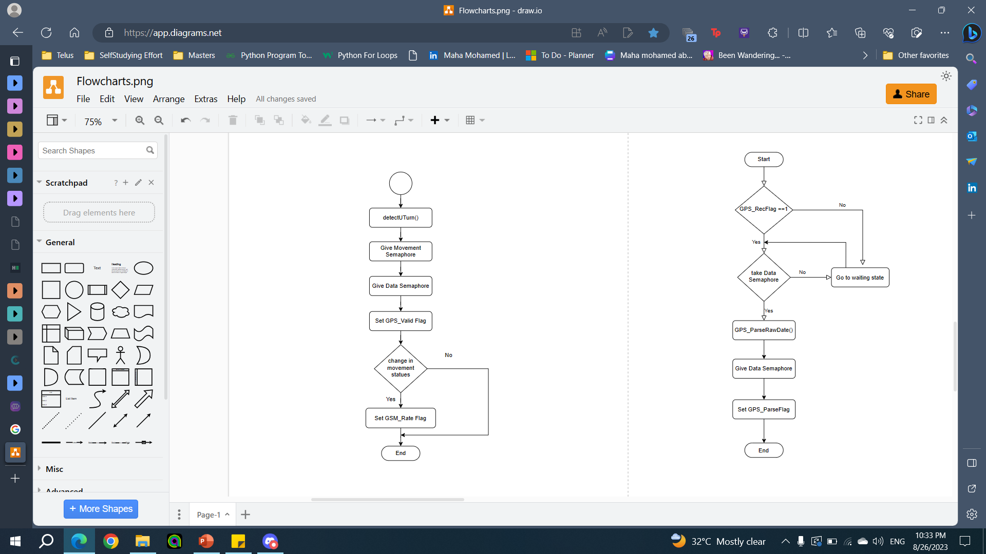
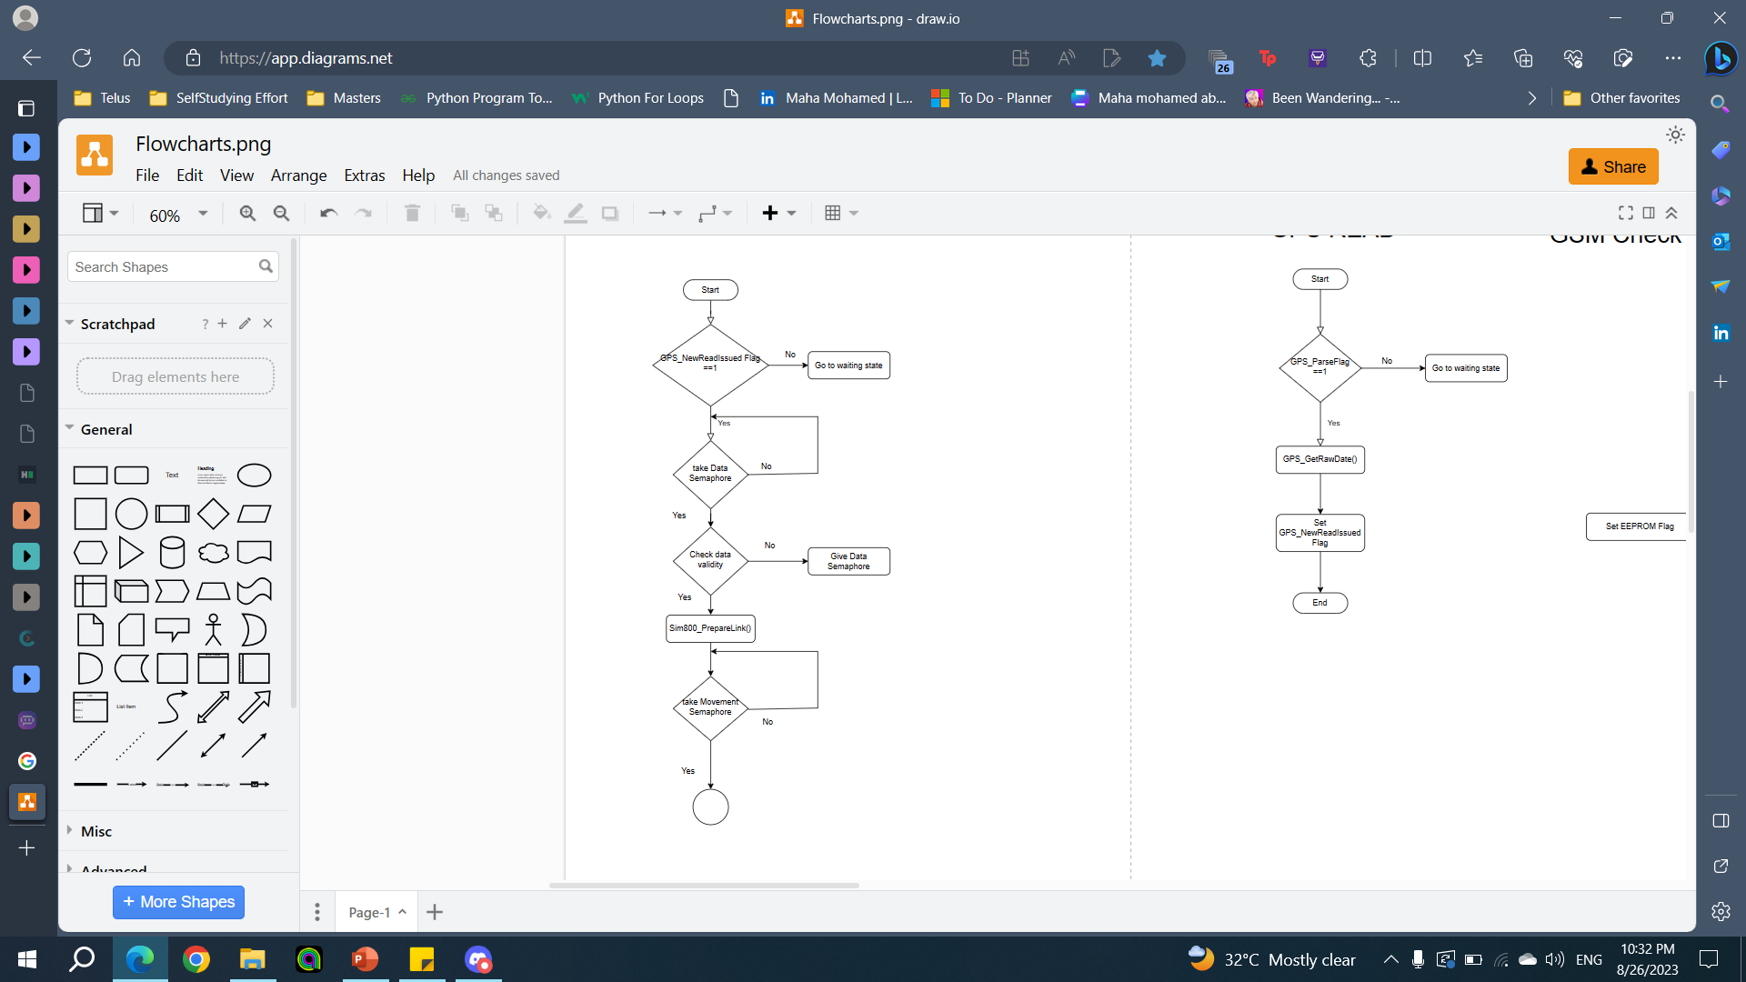
Project analysis slide 4
GPS Process Data

Slide 18
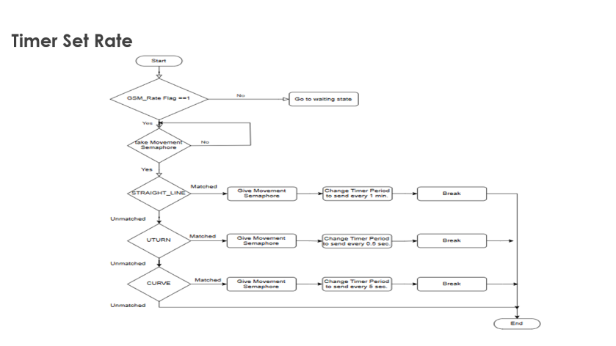
Project analysis slide 4
Timer Set Rate
Timer period will change according to the movement statues.

Slide 19
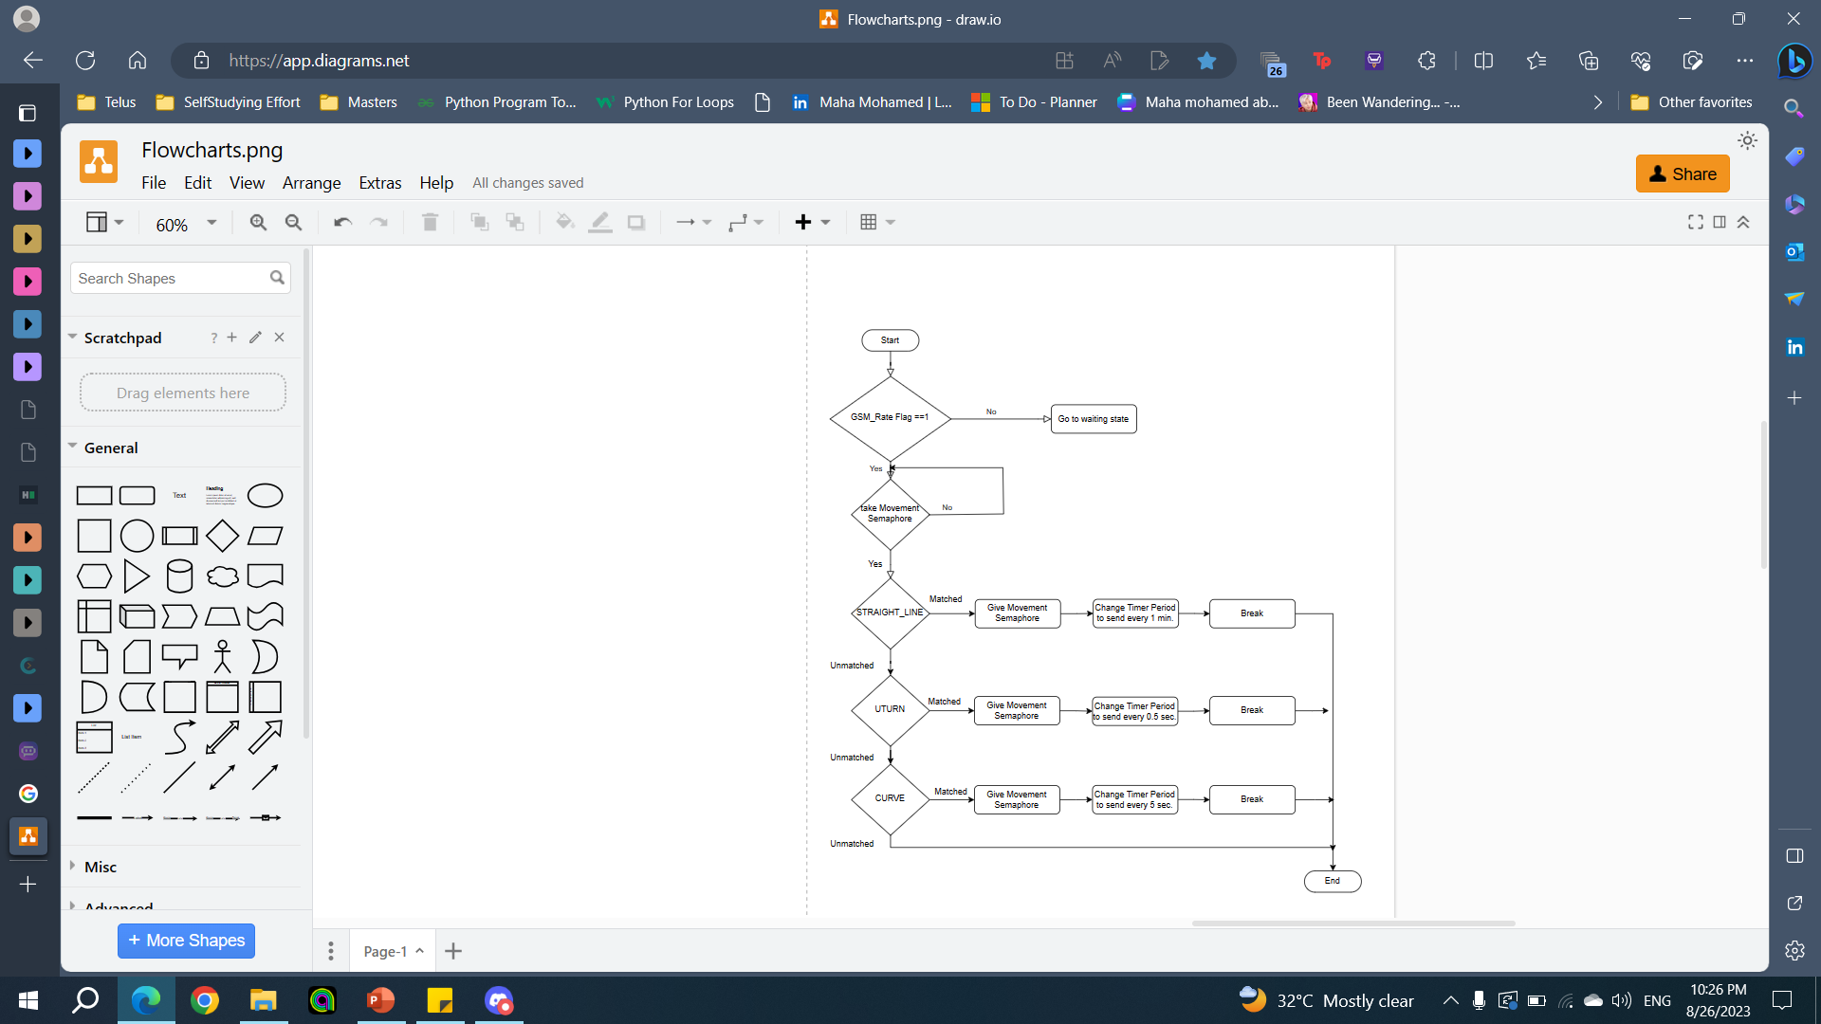
Project analysis slide 4
Timer Set Rate

Slide 20
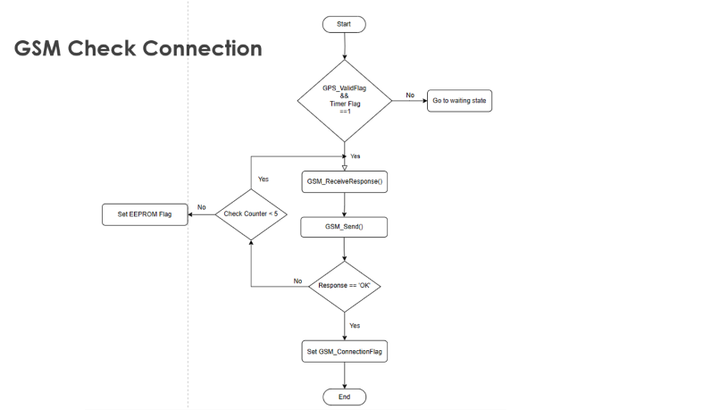
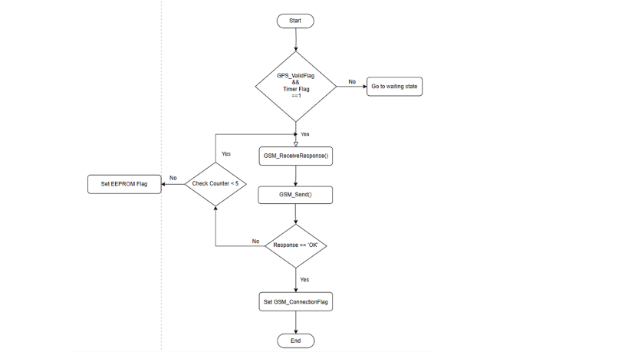
Project analysis slide 4
GSM Check Connection
GSM_ReceiveResponse enables DMA channel to start receiving from UART2 Rx.
GSM_Send sends enable SSL command.
If GSM responds with “OK”, GSM_Connection flag is set.
If GSM responds with “ERROR”, re-send test command

Slide 21
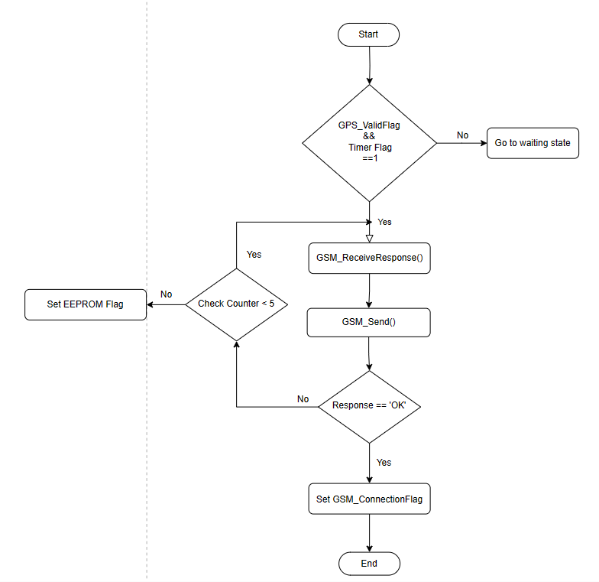
Project analysis slide 4
GSM Check Connection

Slide 22
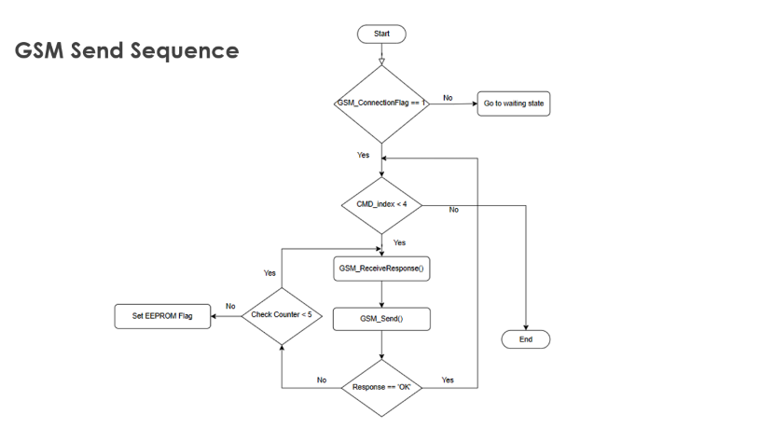
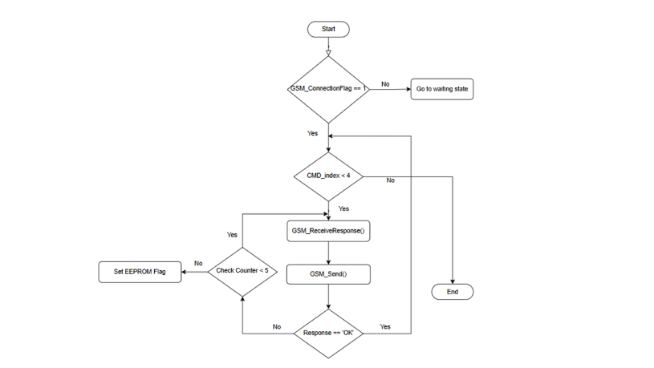
Project analysis slide 4
GSM Send Sequence
Loop over and send HTTP commands.
If GSM responds with “OK”, command is sent successfully.If GSM responds with “ERROR”, re-send test command
If GSM responds with “ERROR”, re-send test command

Slide 23
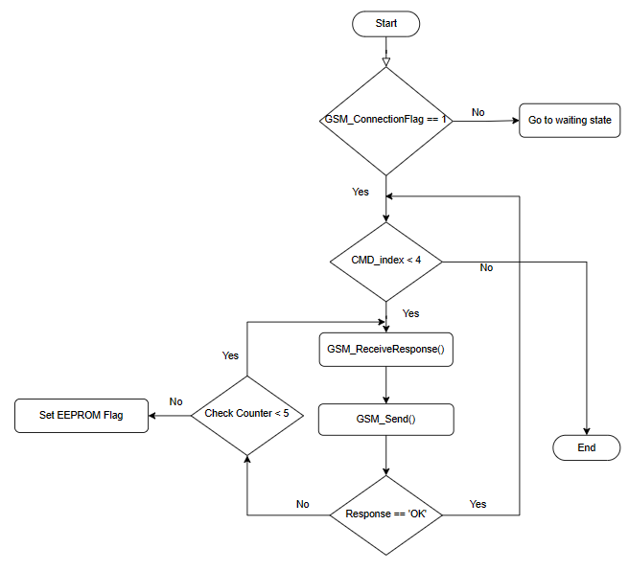
Project analysis slide 4
GSM Send Sequence

Slide 24
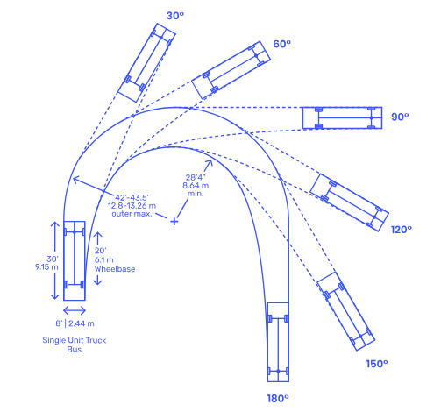
Project analysis slide 10
Path Detection
HOW TO DETECT CAR IF IT IS IN A CURVE, UTURN OR STAIGHT LINE?
Maximum speed on curve should be calculated.
⇒ mv2/R​=μmg
While R is radius.
By getting maximum velocity we could calculate change in car angle per one second.

Slide 25
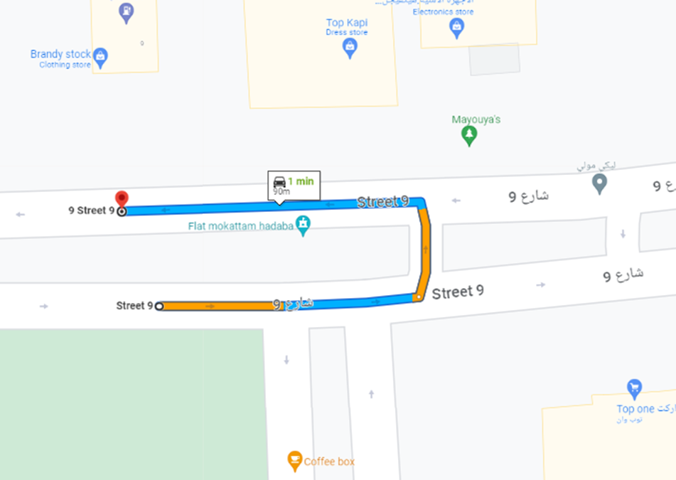
Project analysis slide 10
Path Detection
Degree Change > 30 degree /s
Code :
if ( ( speed <= High_Speed) && (angleChange > UTRURN_ANGLE))
{
Status = UTURN; //DOING A UTURN OR PARKING
}

Slide 26
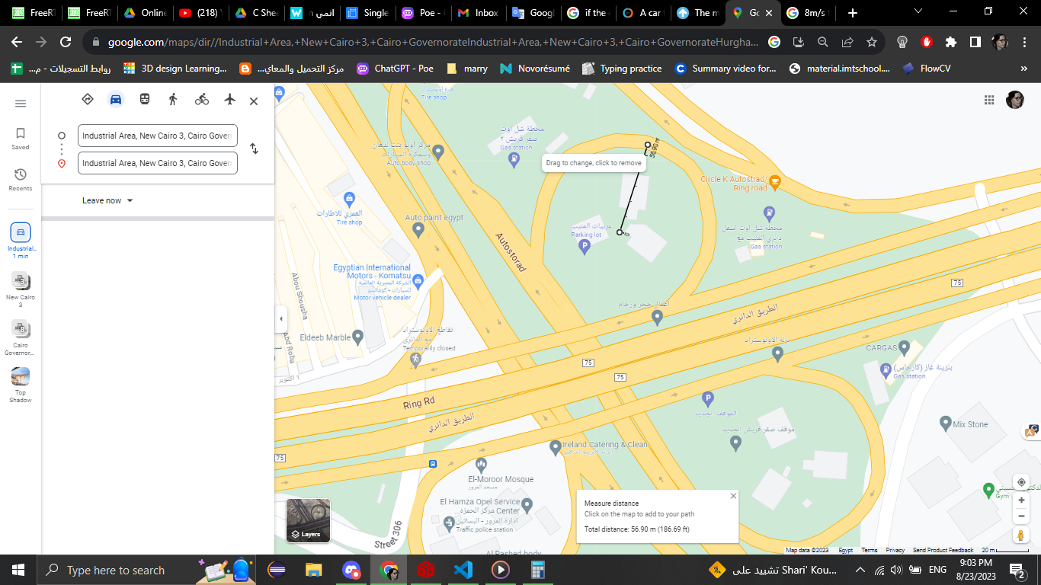
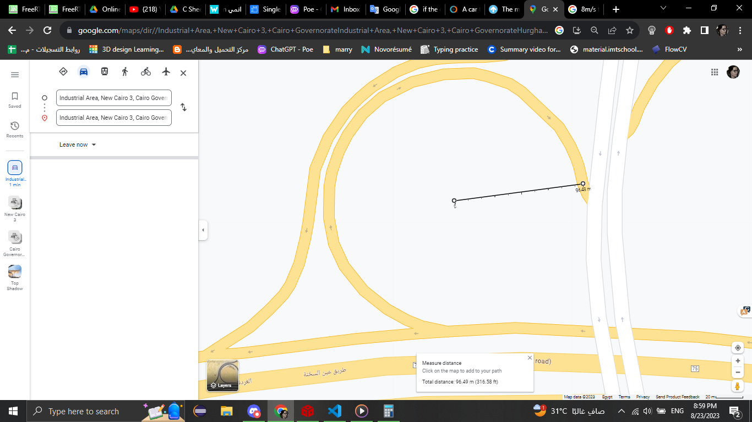
Project analysis slide 5
Curve Detection
Degree Change > 4 degree /s
46 METER RADUIS
105 METER RADUIS
CODE
else if ((speed >= Low_Speed ) && ((angleChange > CURVE_ANGLE) && (angleChange < UTRURN_ANGLE )))
{
Status = CURVE; //CURVING ON A LARGE RADUIS
}

Slide 27
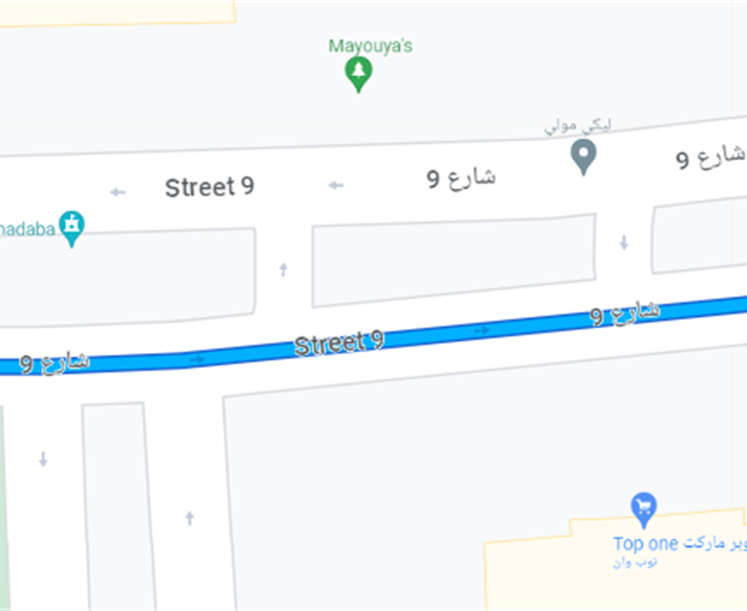
Project analysis slide 10
Straight Line Detection
Degree Change almost 0 degree /s
Code:
{
Status = STRAIGHT_LINE;
}

Slide 28
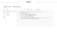
Project analysis slide 4
Web Interface
Script
The Script processes received data and fills it in google sheet
Google Sheet
Formats data to be read by Google Looker.
Google Looker
Each location is then drawn on the map forming a track
GSM
GSM sends data to the script in a specific format

Slide 29
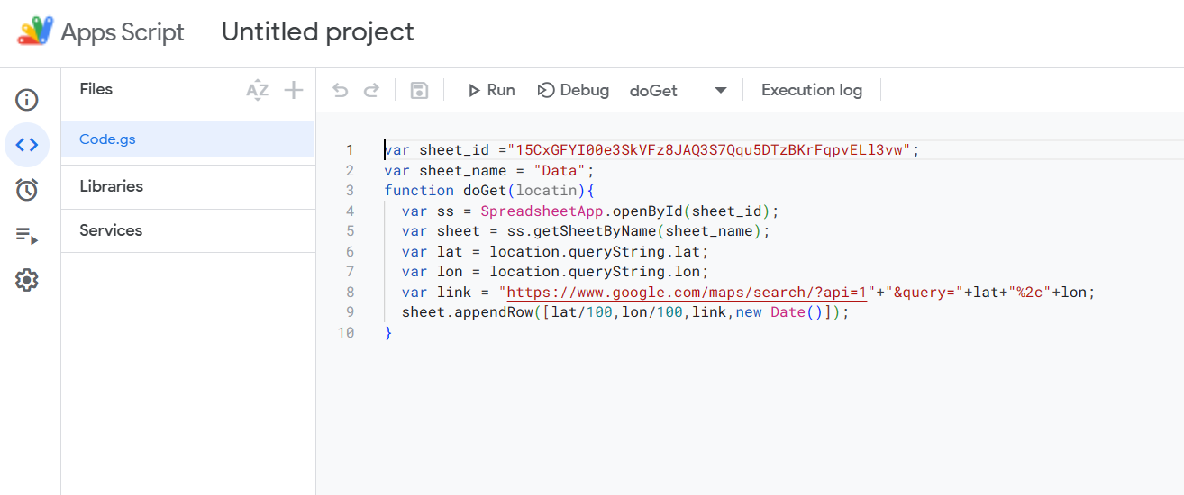
Project analysis slide 4
Script

Slide 30
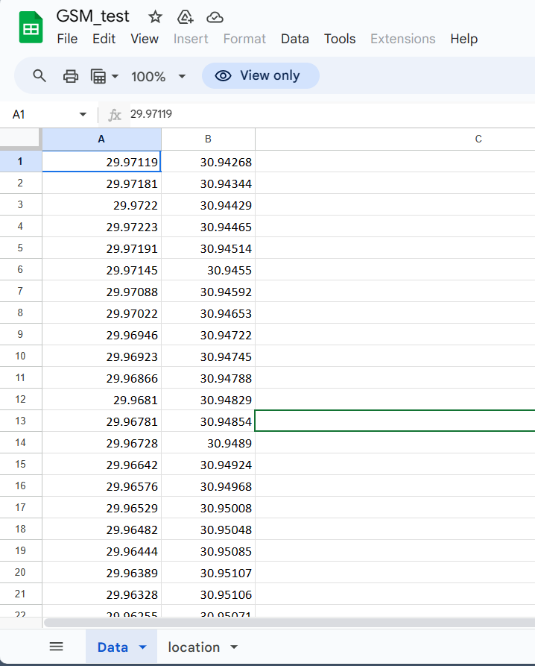
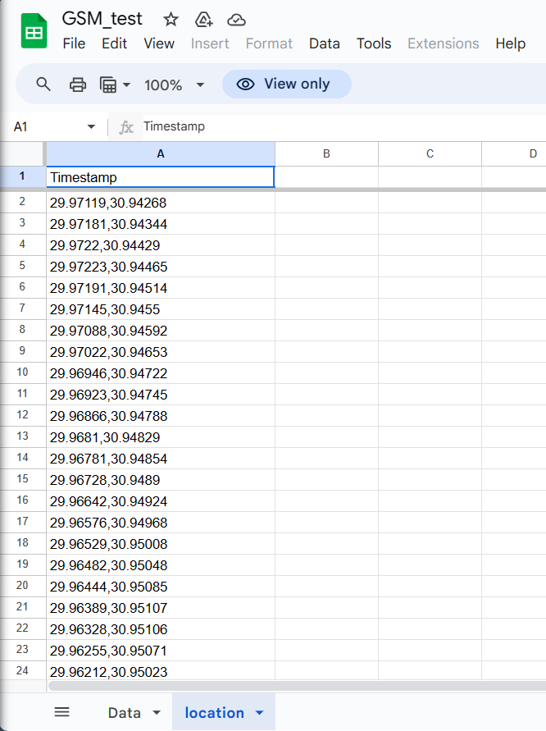
Project analysis slide 4
Google Sheet

Slide 31
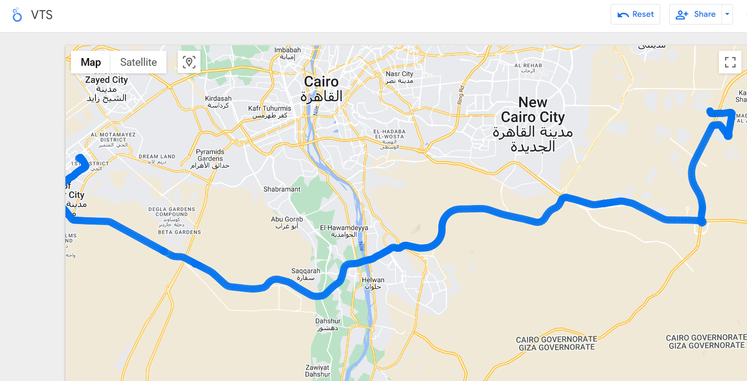
Project analysis slide 4
Google Looker

Slide 32
Thank You

